Slide 1


Building a basic classification model
Video 7: Limitations of ANN

Slide 2
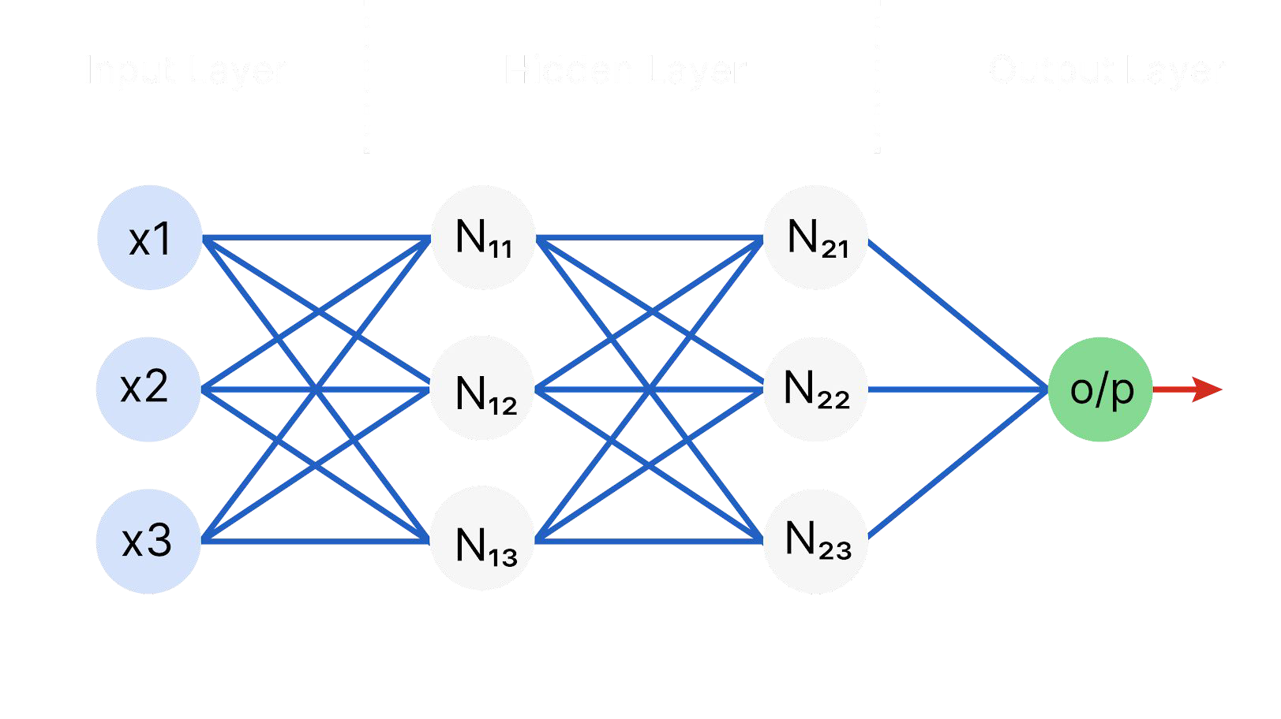
ANN Architecture

Slide 3

Limitations of ANN
1
Fixed Input Size

Slide 4
Limitations of ANN
1
Fixed Input Size
Inputs

Slide 5
Limitations of ANN
1
Fixed Input Size
Inputs
choose
bound
storyline
insanely
huge
entire
far
long

Slide 6
Limitations of ANN
2
Fixed Output Size
Inputs
Limiting its effectiveness in text generation task such as translation , summarization etc.

Slide 7
Limitations of ANN
3
Unable to process sequential data
Inputs
Order and Relationship between inputs are not considered.
Example : Understanding sentence and next word prediction.

Slide 8
Limitations of ANN
3
Unable to process sequential data
Inputs
Order and Relationship between inputs are not considered.
Example : Understanding sentence and next word prediction.

Slide 9

Limitations of ANN
Complete the following sentence.
“Life is full of .”

Slide 10
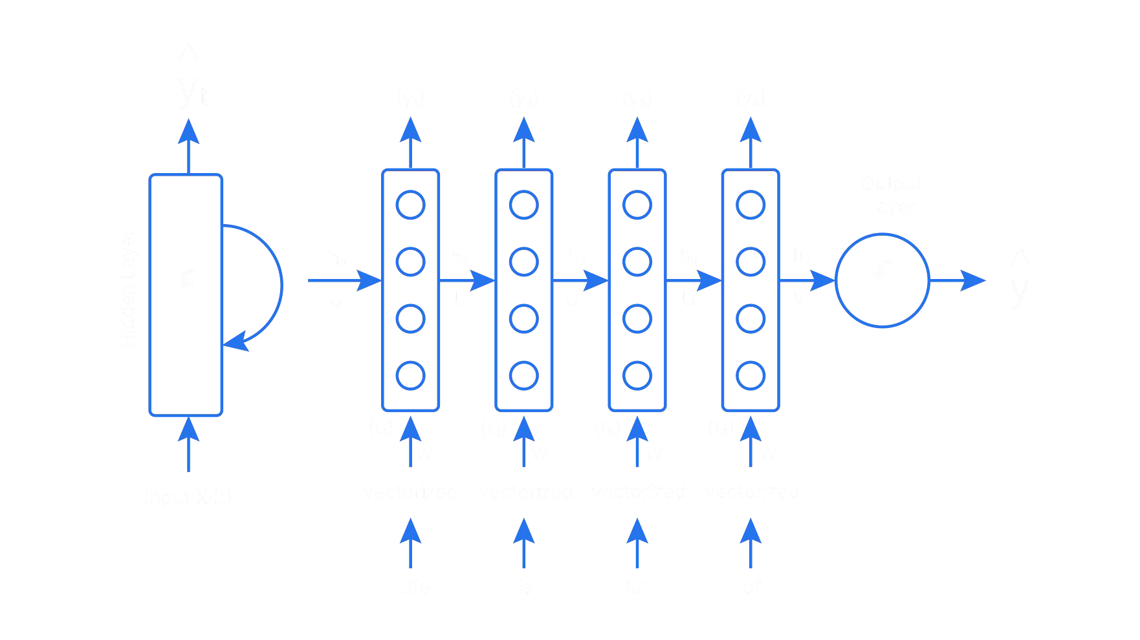
Recurrent Neural Network
X₁
X₂
X₃
X₄

Slide 11
In air

